Slide 1

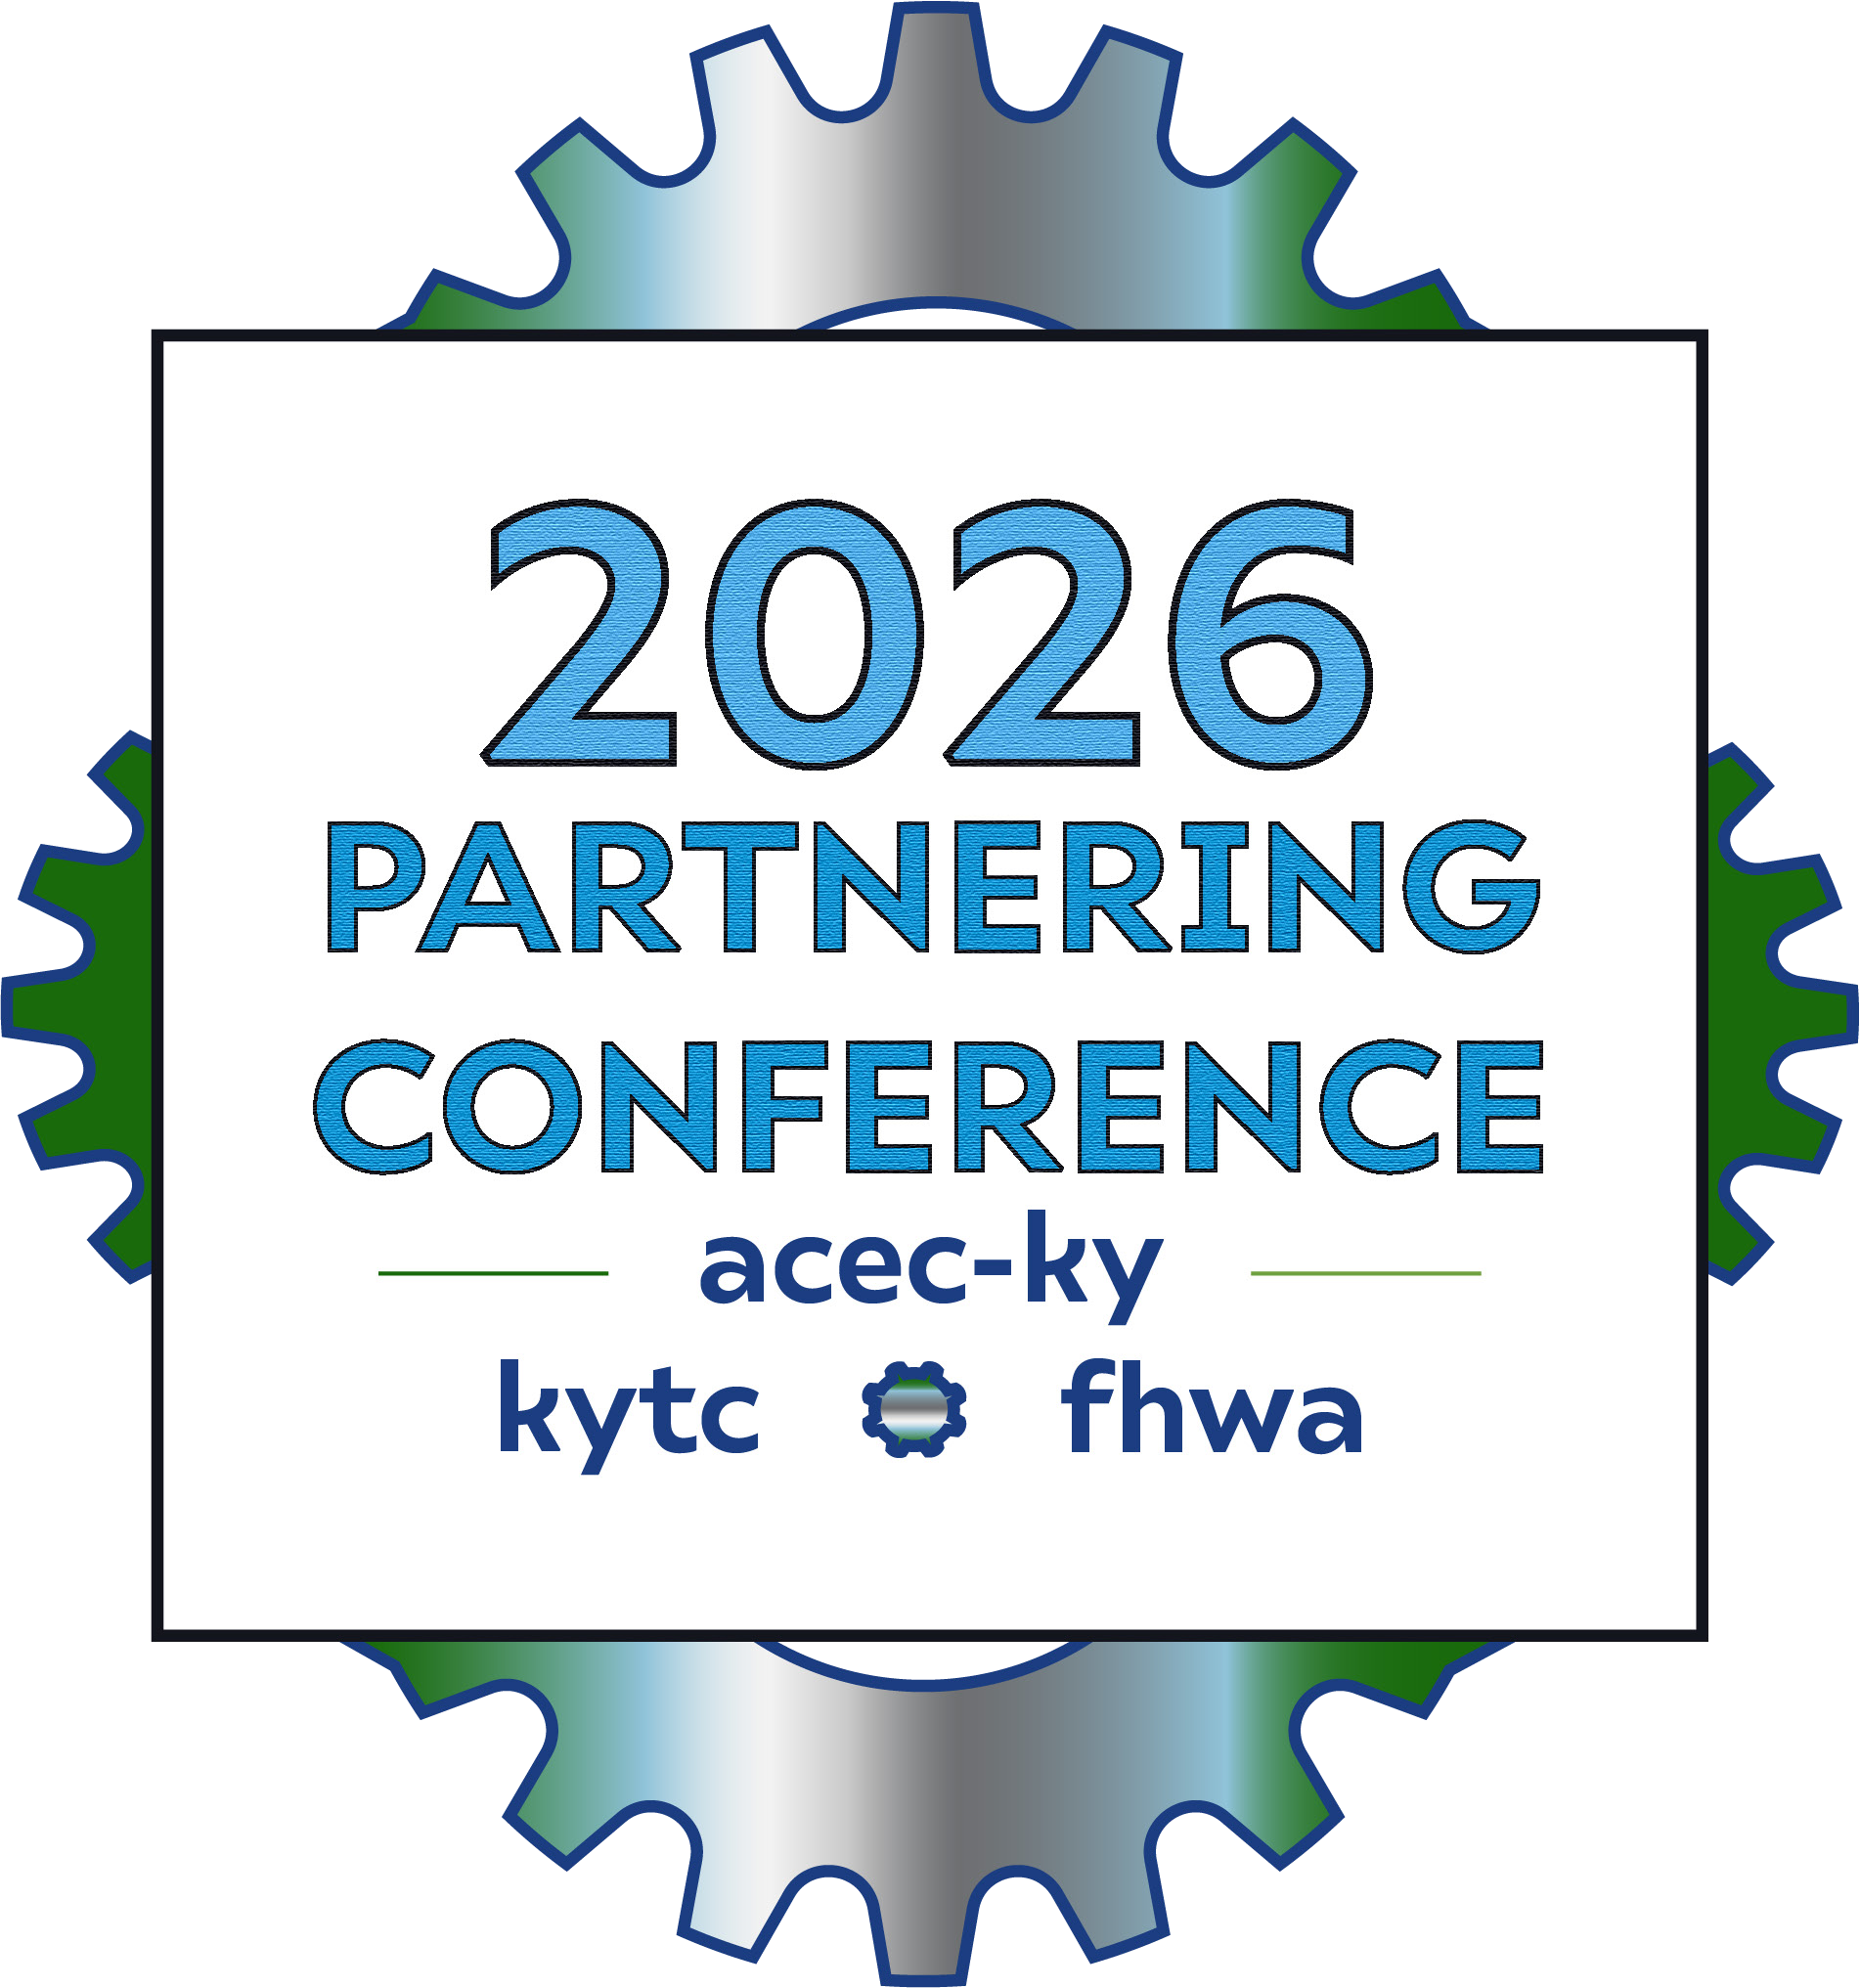
Utility Relocation
Inspection Standards
Lisa Johanningsmeier – D5 Utilities
Allen Rust – Central Office Rail Coordinator
Notes:
Utility coordination is essential for reducing cost and scheduling delays during construction of any roadway project. Most of this coordination occurs before any field work begins. But utility coordination does not end with planning, it continues into construction. That is where utility relocation inspections comes in.

Slide 2


Why Utility Inspection?
FHWA Utility Relocation and Accommodation on Federal-Aid Highway Projects Program Guide
says we must perform inspections during utility relocations. 23 CFR 645.115
KYTC Utilities and Rails Guidance Manual says we must perform inspections during utility relocations. UR-1203-4
Notes:
FHWA policy says we have to. And the KYTC Utilities and Rails Guidance Manual says we are going to follow what FHWA says to do… plus some more detail on how. So, why do the policies say wee need to do utility inspections?
And so we can know what is going on with our project and on our roads

Slide 3
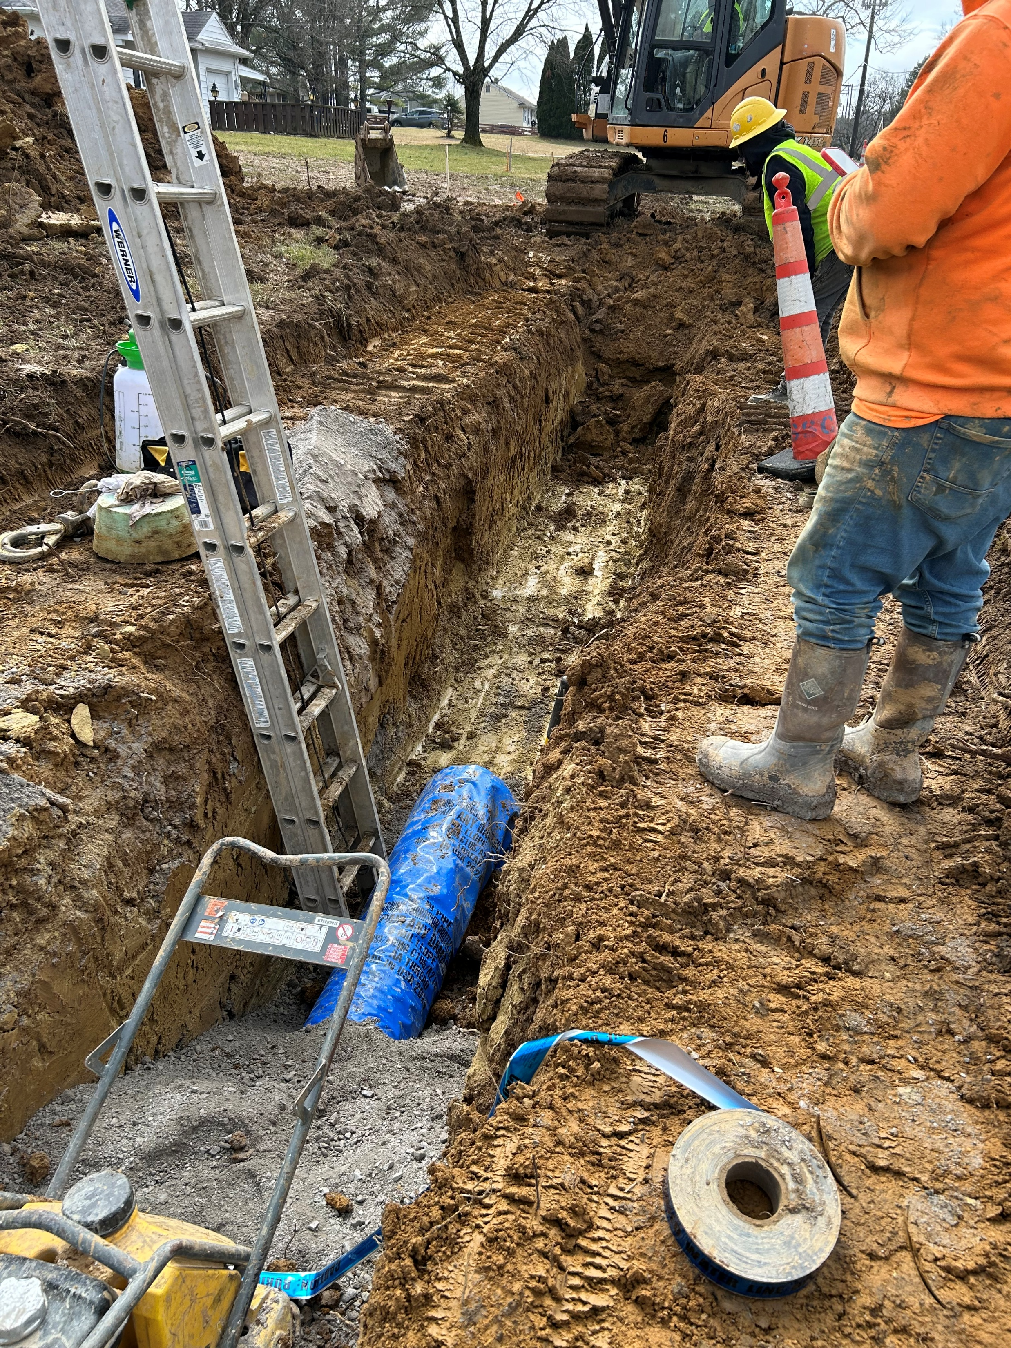
Why Utility Inspection?
We know what is installed on our
roads for our project.
Monitor Progress
Notes:
The key reasons for inspections is so we know what is installed on our roads for our projects, and to monitor progress. We don’t just turn all the utility companies loose to do relocations at once. We have to coordinate when each one can start to not interfere with the work of another.

Slide 4


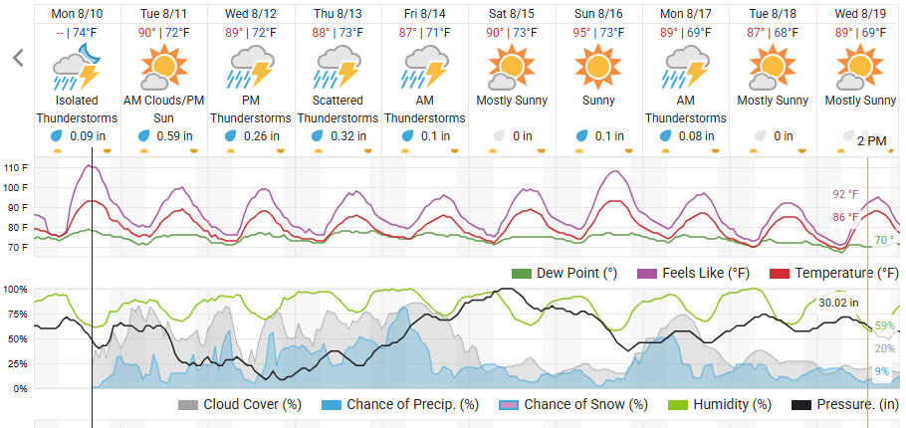
Frequency of Inspection
Overhead Utilities – 1 inspection / week
  Most electric and communications
Underground Utilities – 2 inspections / week
  All gas, sewer, water
  Some electric and communications
* Depending on weather and work activities / schedule
Notes:
Rain happens and holds up some work. Some still can work in the rain, but not lightening.
Some activities are temperature dependent – you can’t weld plastic gas main below 20°
Can’t see 811 marks if it snowed

Slide 5

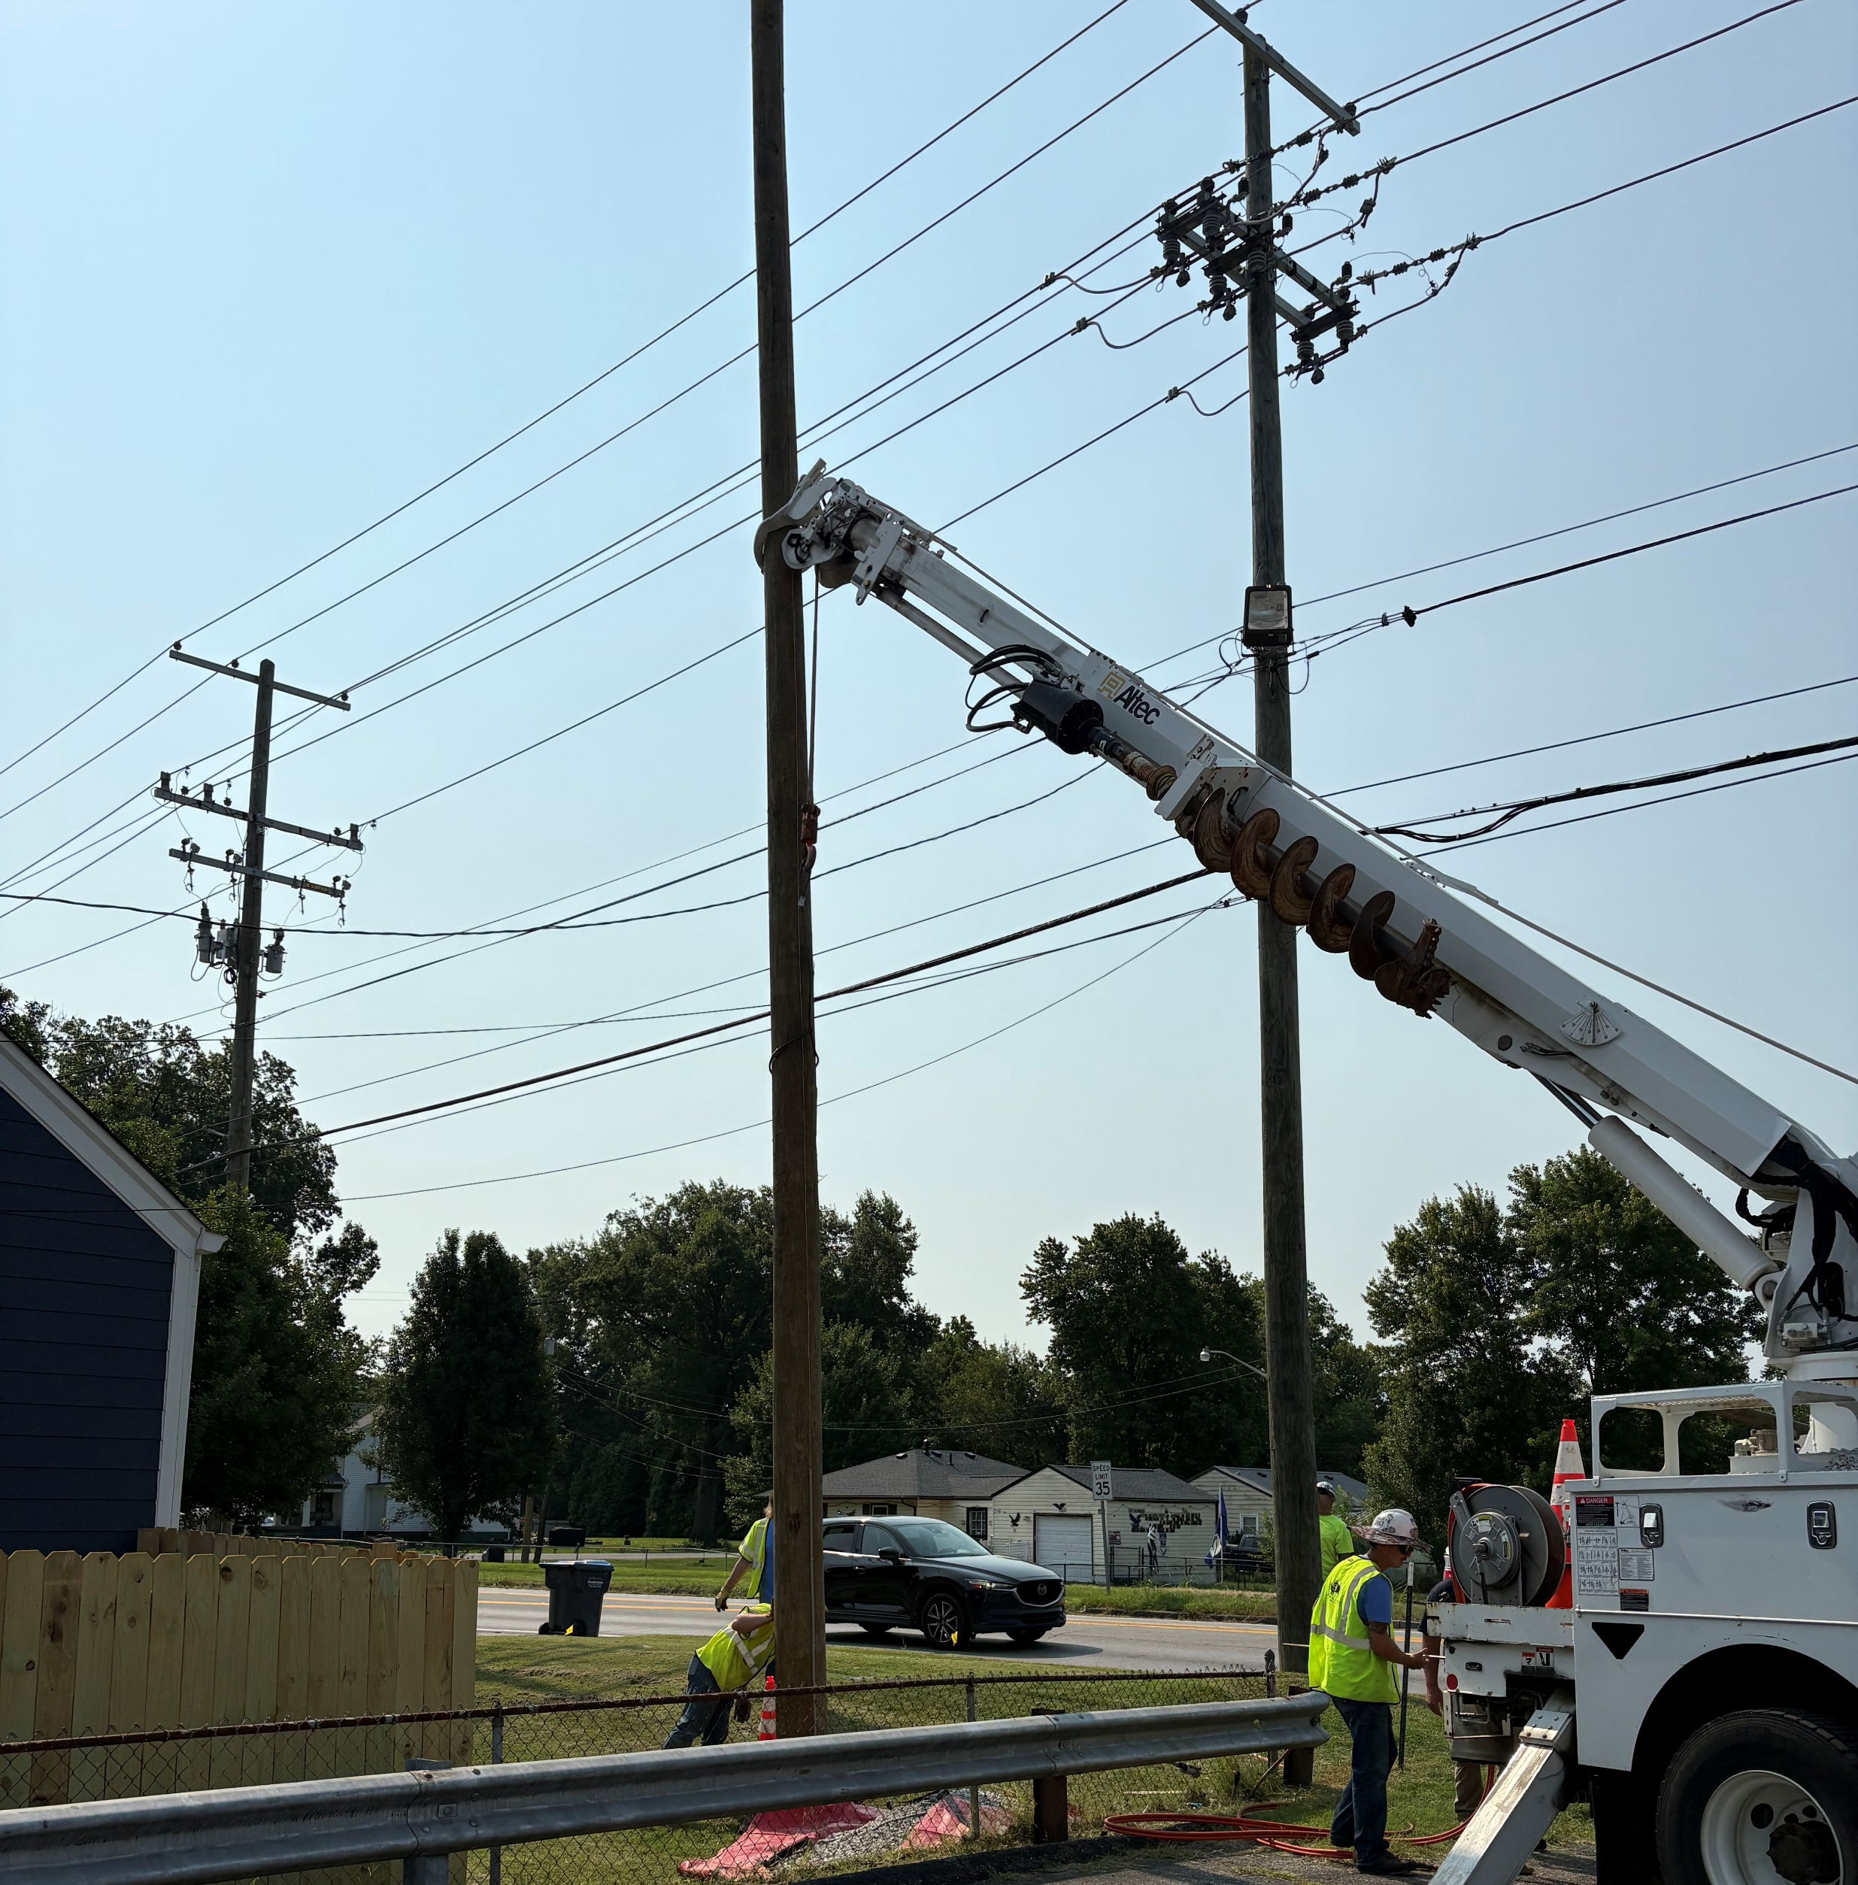
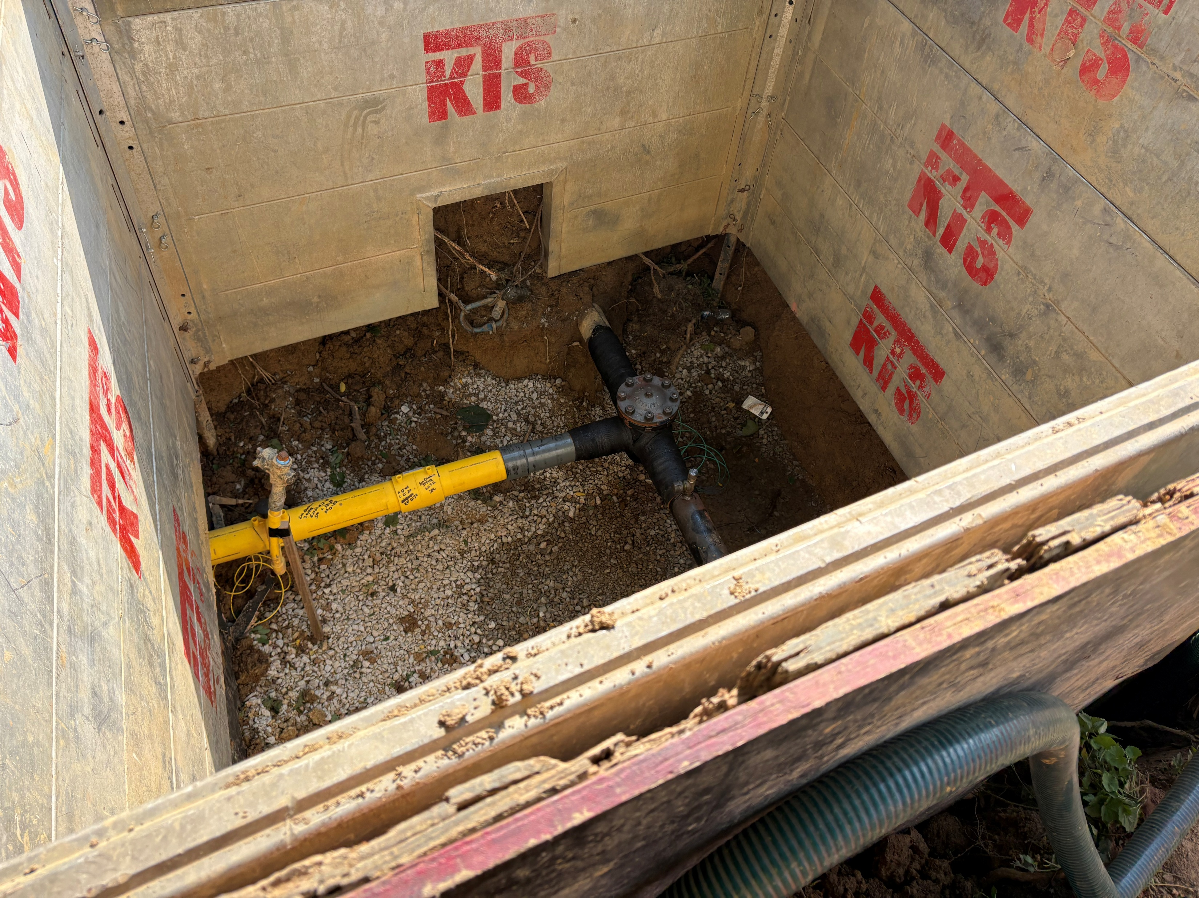
Inspection Information
Compliance with policy and agreement
Safe Operations
Progress and Schedule
Location of work

Slide 6


Compliance with Policy and Agreement
  On any relocation project, all work within the limits of the Cabinet’s right-of-way shall be done in accordance with the Cabinet’s Standards, Specifications, and Standard Drawings. All traffic control will be in accordance with Part VI of the Manual on Uniform Traffic Control Devices & KYTC Permits Manual. Backfilling and bedding, if required and/or necessary, will be performed in accordance with the most recent version of the Roadway Drainage Installations (RDI) section of the Cabinet’s Division of Highway Design Standard Drawings or as directed by the Cabinet’s engineer. Surface restoration, if required, will be performed in accordance with details as shown in the most recent version of the Cabinet’s Standard Specifications for Road and Bridge Construction and the Permits Manual, or as directed by the Cabinet’s engineer.
Notes:
Are they doing what they told us they would do according to how we say they need to?
The utilities determine how they need to install their facilities. We specify how to handle the work around their facilities.
Here, we can see from one of our agreements, we reference what specifications they need to follow for different types of work. Work within the right-of-way, Traffic control, Backfilling and bedding, and Surface restoration.

Slide 7

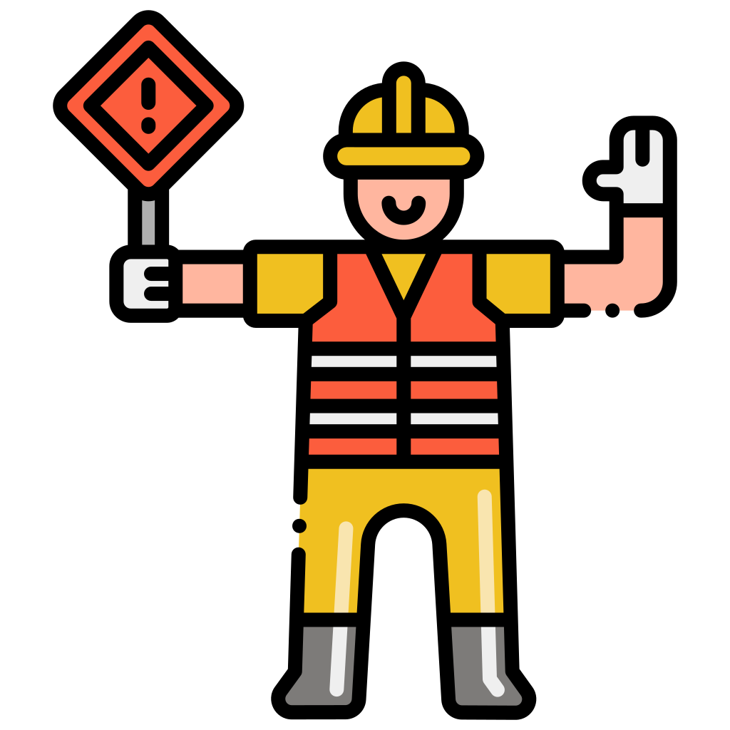
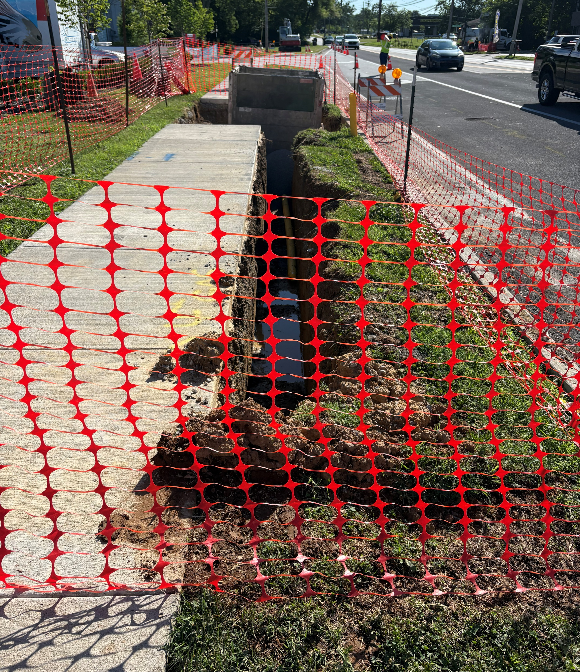
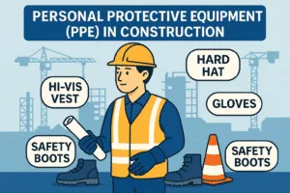
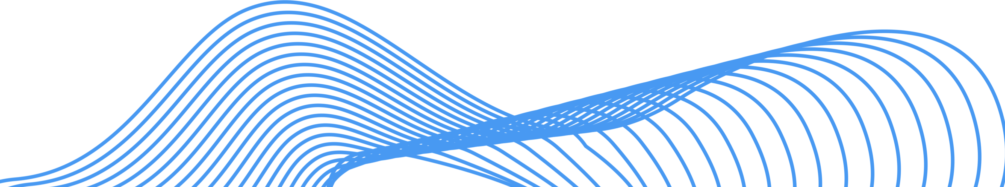
Safe Operations
811 locates visible during any underground work
Spotting utilities before digging / boring
Traffic controls
Workers wearing PPE
Excavations properly protected
Notes:
We are not OSHA, but there are some things we can look for.
Spotting utilities. If boring you may cross some other utilities. 811 markings don’t tell you depth. So before they start to bore, every 811 mark in that path gets vacuum excavated to verify location and depth.
This excavation, running along a sidewalk. The stretch of sidewalk is fenced off and there are sidewalk closed signs. There is also a trench box to protect works when they are in there.

Slide 8
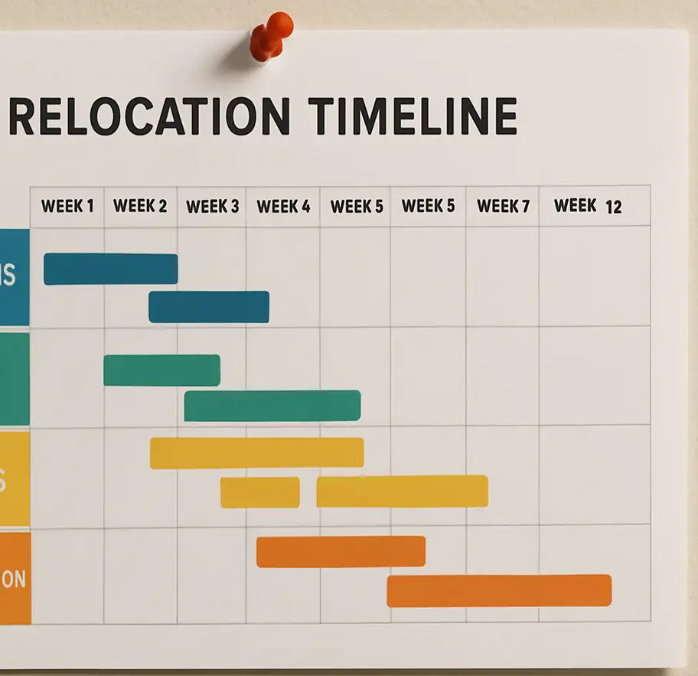
Progress and Schedule
Unanticipated field conditions
  Weather
  Soil conditions
Materials delays
Field – Office disconnect
Notes:
Several external factors impact progress. Weather being the most obvious. Soil conditions – you could encounter rock that wasn’t anticipated. Sometimes, there can be a utility line that wasn’t previously known.
Field-office disconnect. I’ve seen everywhere, not just with utilities or roadwork. How long and engineer might think something takes is different than what the people doing the work think.
Knowing the actual field progress allows us to better let the next utility to know when to start. Can also affect letting date.

Slide 9

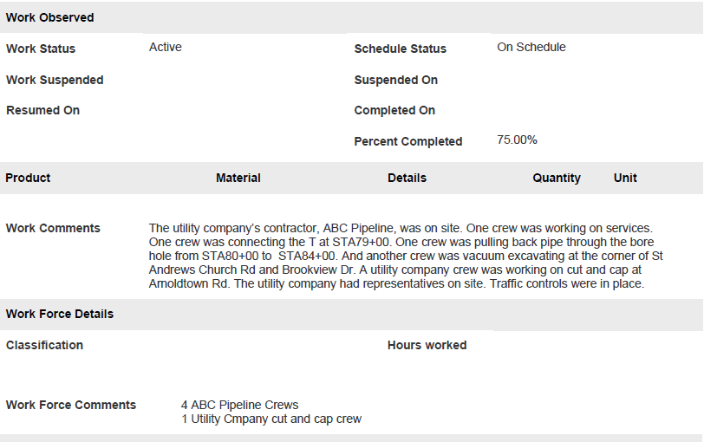
Inspection Recorded in KURTS
Notes:
Kurts is where all the utility and railroad work is documented. Agreements, State Letters, Notice to Proceed, Invoicing, and Inspections.
Example of inspection report with no utility of contractor names
Detail the location and brief description of work.
Comment about traffic
Some utilities will have their own inspector on site. Note that.
Multiple crews working – 4 contractor crews, 1 utility crew

Slide 10
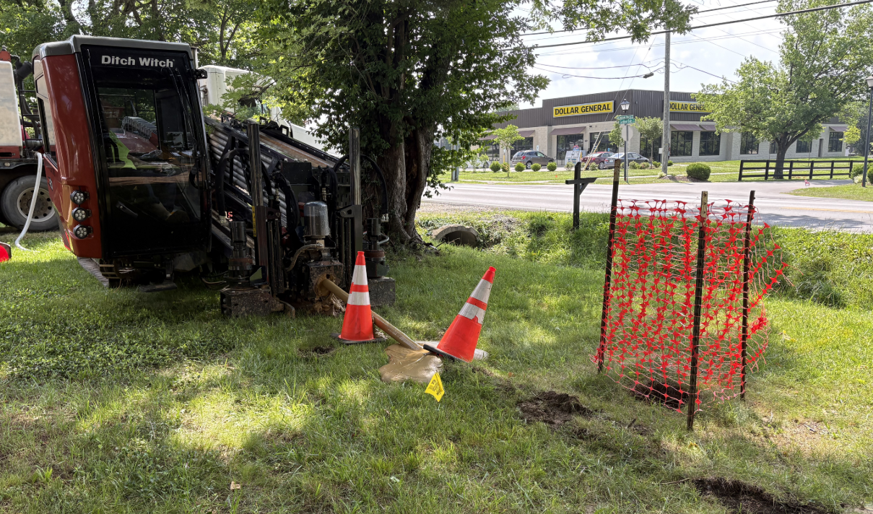
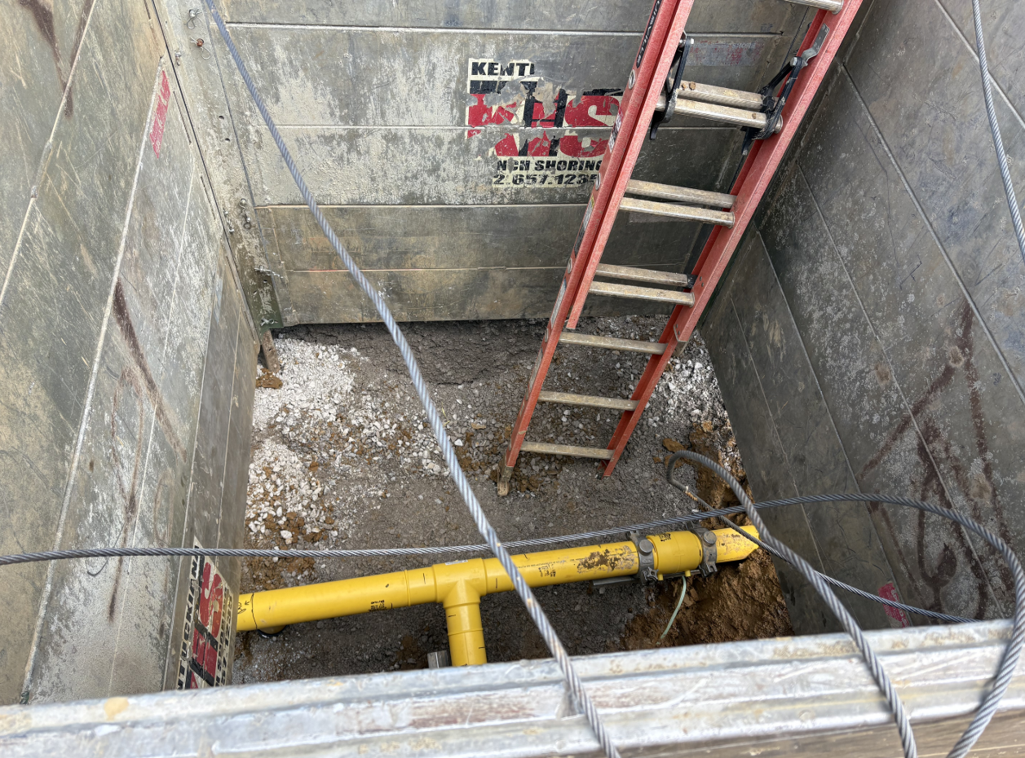
Inspection Recorded in Kurts
Notes:
Pictures or it didn’t happen.
Pictures can provide details that words can’t
Here we see a bore rig drilling. The mailbox and Dollar General help give approximate location.
And here we can see the clamps on each side of the coupler for this gas main. They had finished welding and were waiting the required period for it to cool.

Slide 11
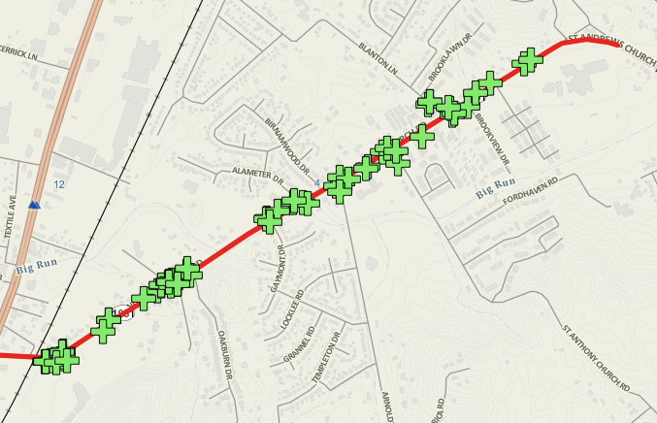
Location of Work
Notes:
Location of work for all KURTS reports for the gas relocation on this project.

Slide 12
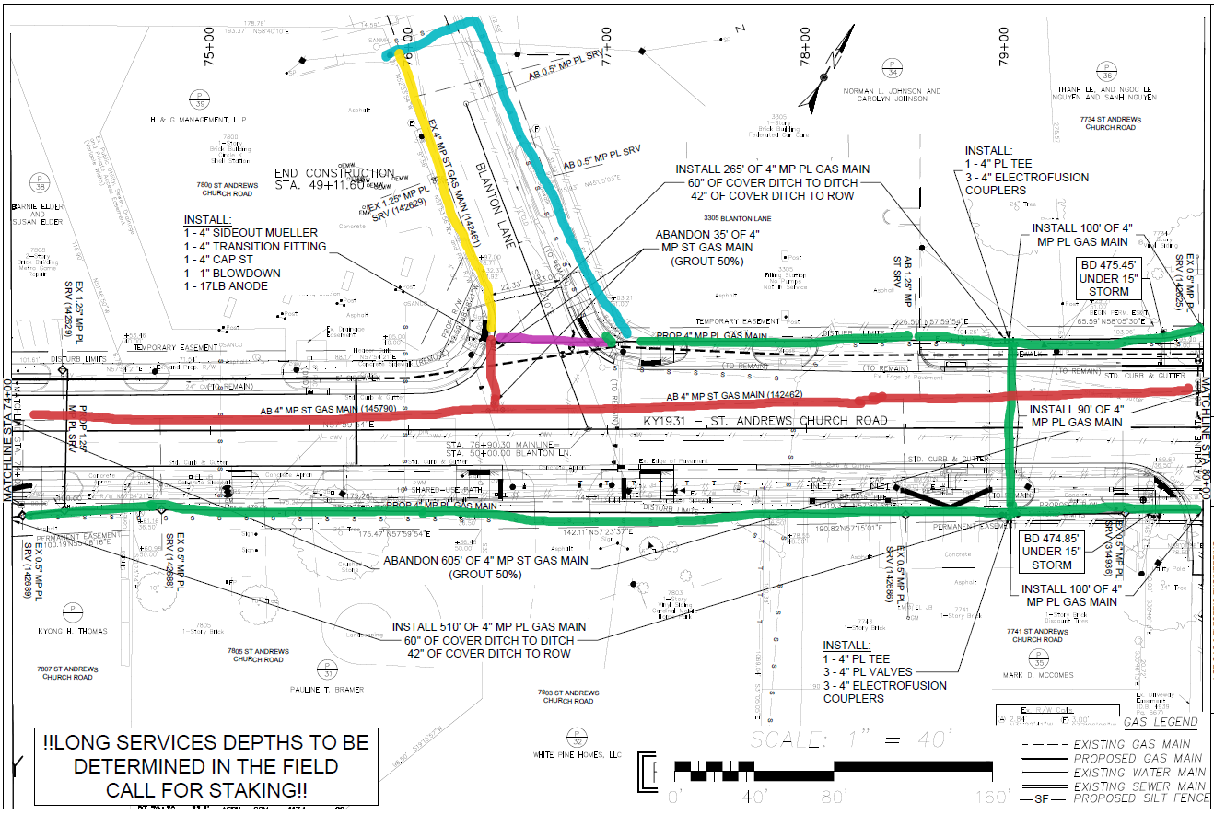
Location of Work
Notes:
Mark up relocation plans. Note field changes
Green – Installed and gassed up as planned
Red – abandoned as planned
Purple – Planned new, but not installed because of field change due to site constructability problems
Blue – New install that was not on original plans
Yellow – existing that was abandoned due to field change

Slide 13

Other Benefits on Utility Inspection
Build partnership with the people doing the work
Improve communication with utilities
Better understanding of what it takes to move the utilities
Not stuck in an office all day!
Stay Safe and Have Fun!
Notes:
By going in the field, I’ve had the opportunity to build a relationship with those doing the actual work and the utility company inspectors. First time you see a crew, and they see KYTC on the vehicle, they think I’m there to tell them they are doing something wrong. Once they get to know me, they will reach out and let me know of changes, problems, or to ask questions.
Improve communications with the utilities.
We gain understanding of what it takes to move the utilities. I had construction experience when I started, but I didn’t know about utility construction other than 811 colors. 95% of the people in the field love the chance to teach someone what they are doing. I have learned a lot from them that I could have learned any other way.
I’m not stuck inside all day! But I do get to come in when the weather is bad.
And as I always tell the field crews before I leave, stay safe and have fun.

Slide 14
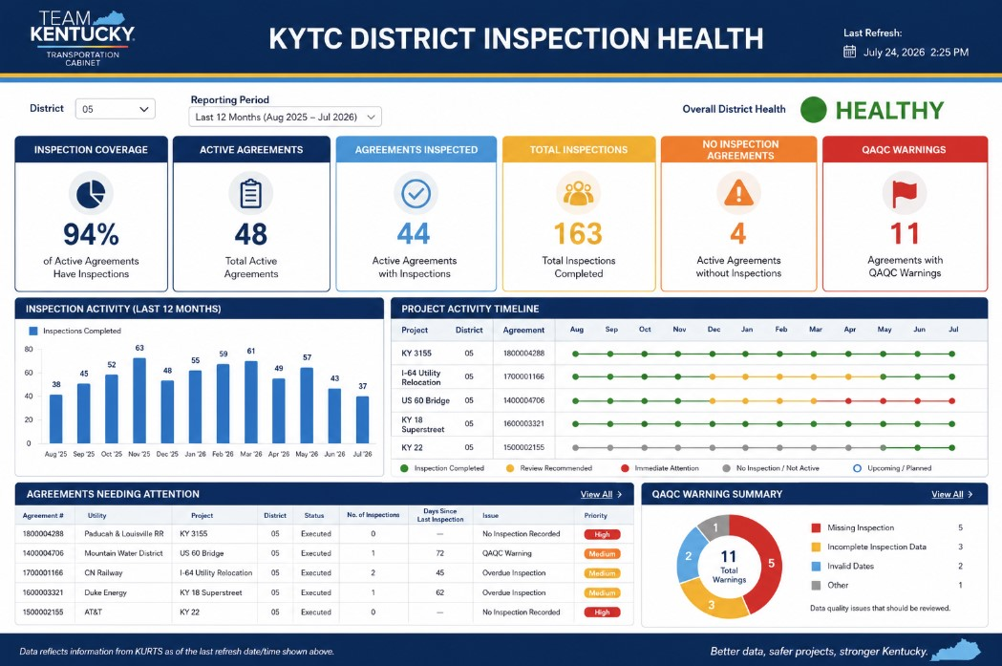
Inspection Health Dashboard

Slide 15
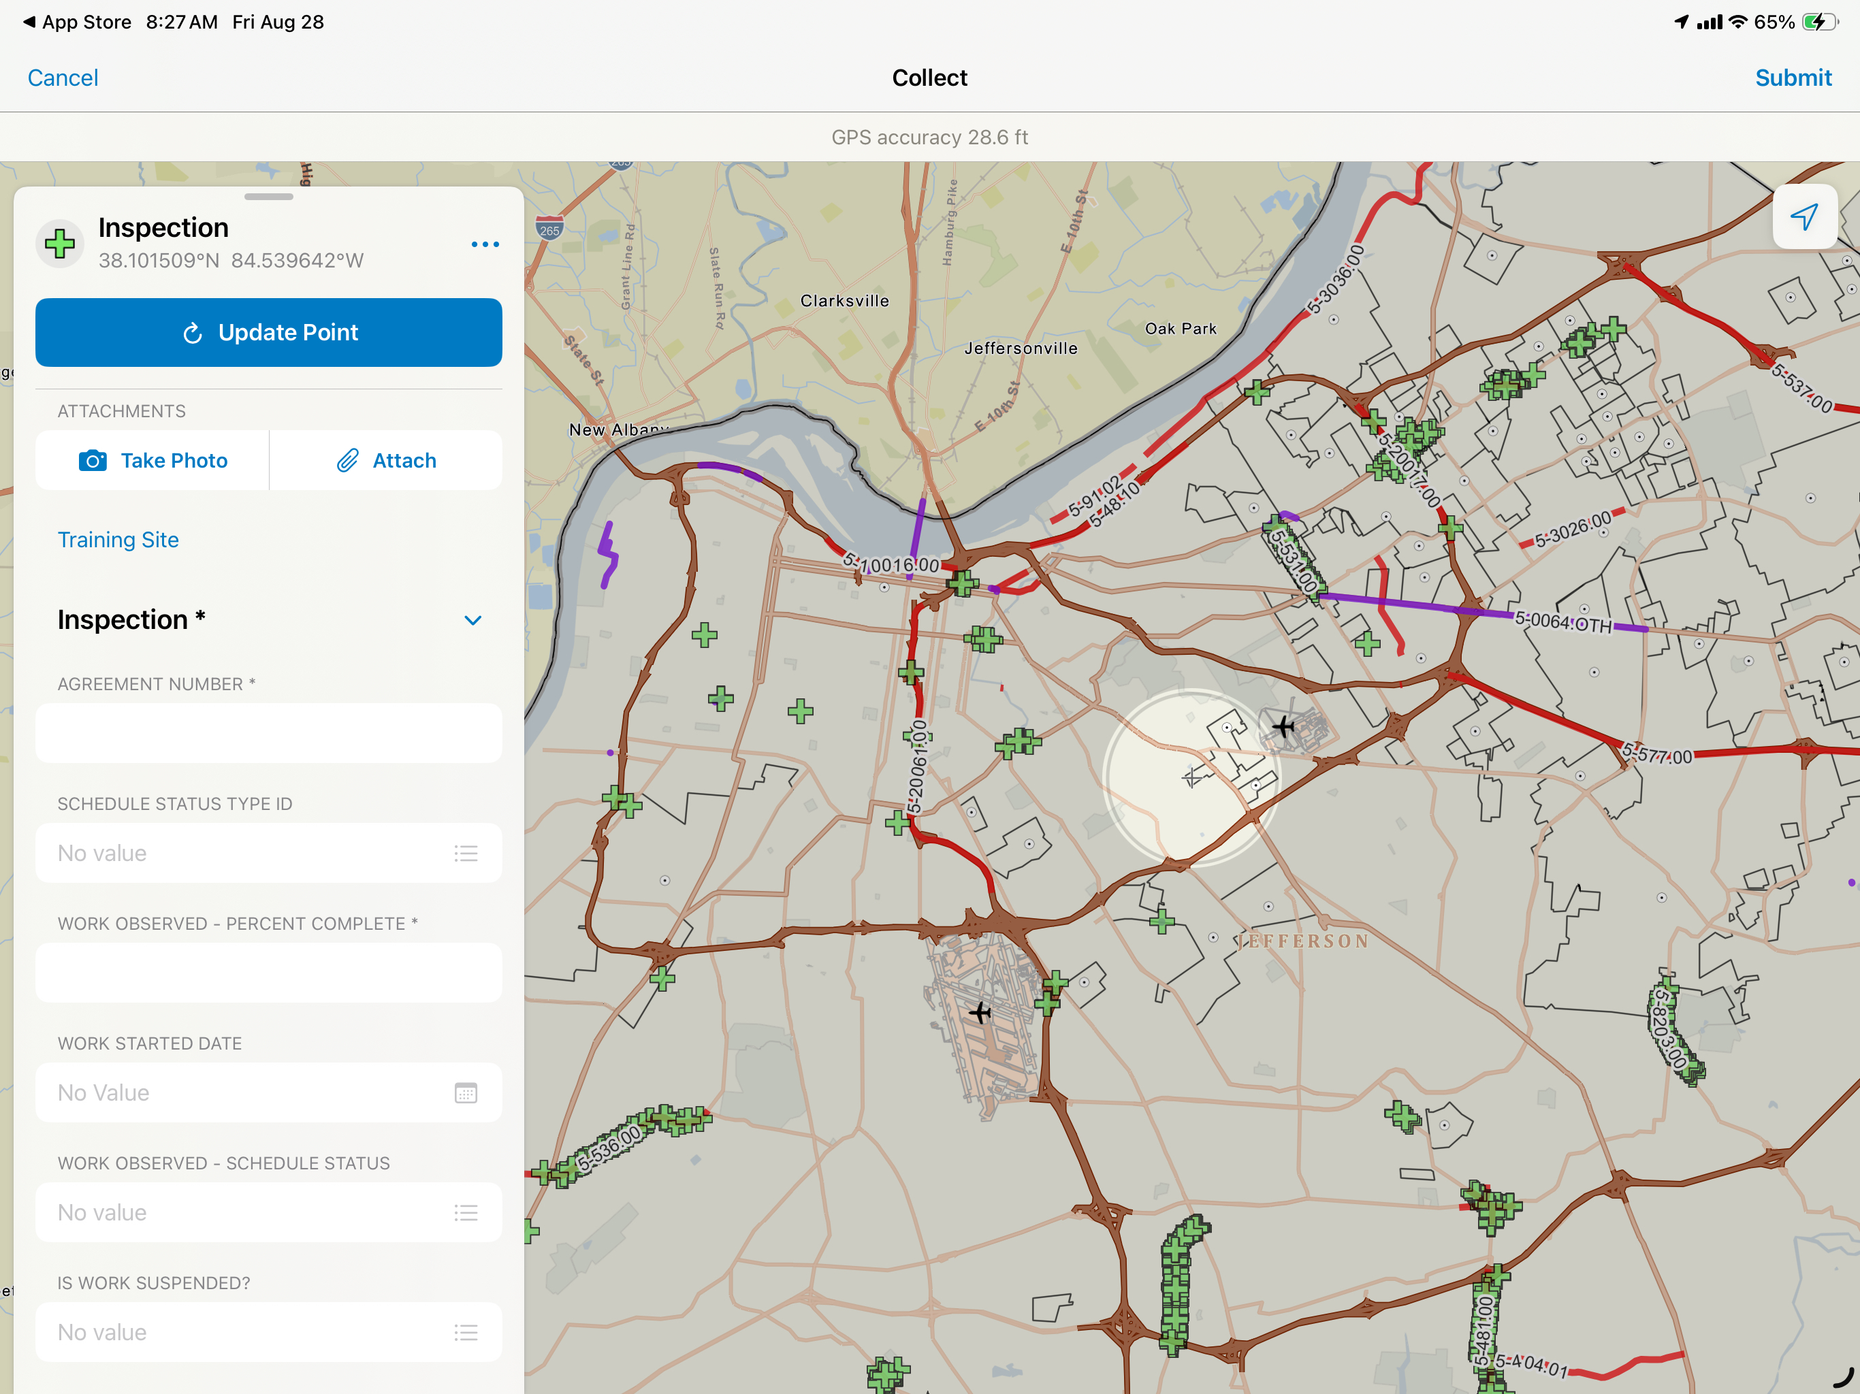
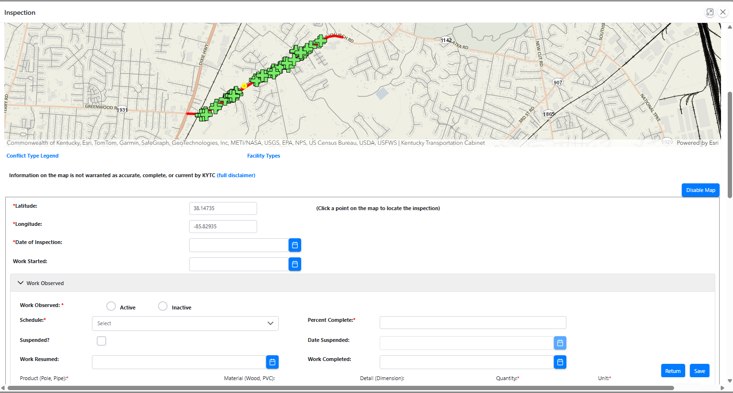
How to Record Inspections
KURTS Mobile KURTS Web App

Slide 16
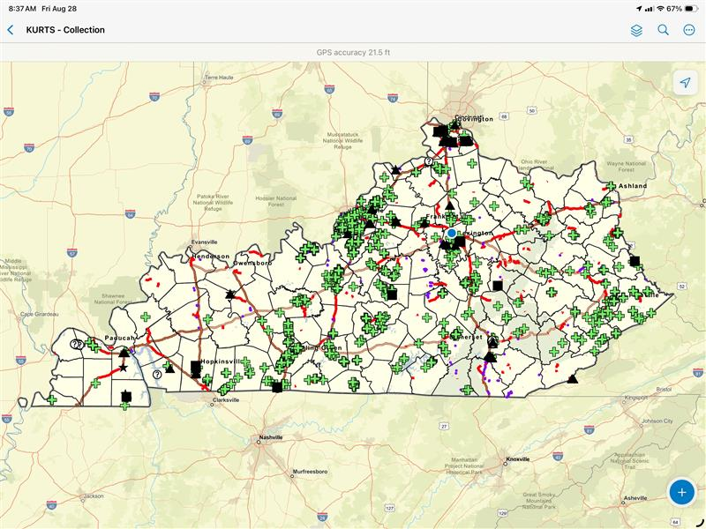
KURTS Mobile
Field Maps app by ESRI
Downloadable onto any iPad, iPhone, Android
Allows offline maps and collection
Also collects data for Conflict Matrix
*Not available to consultants yet

Slide 17
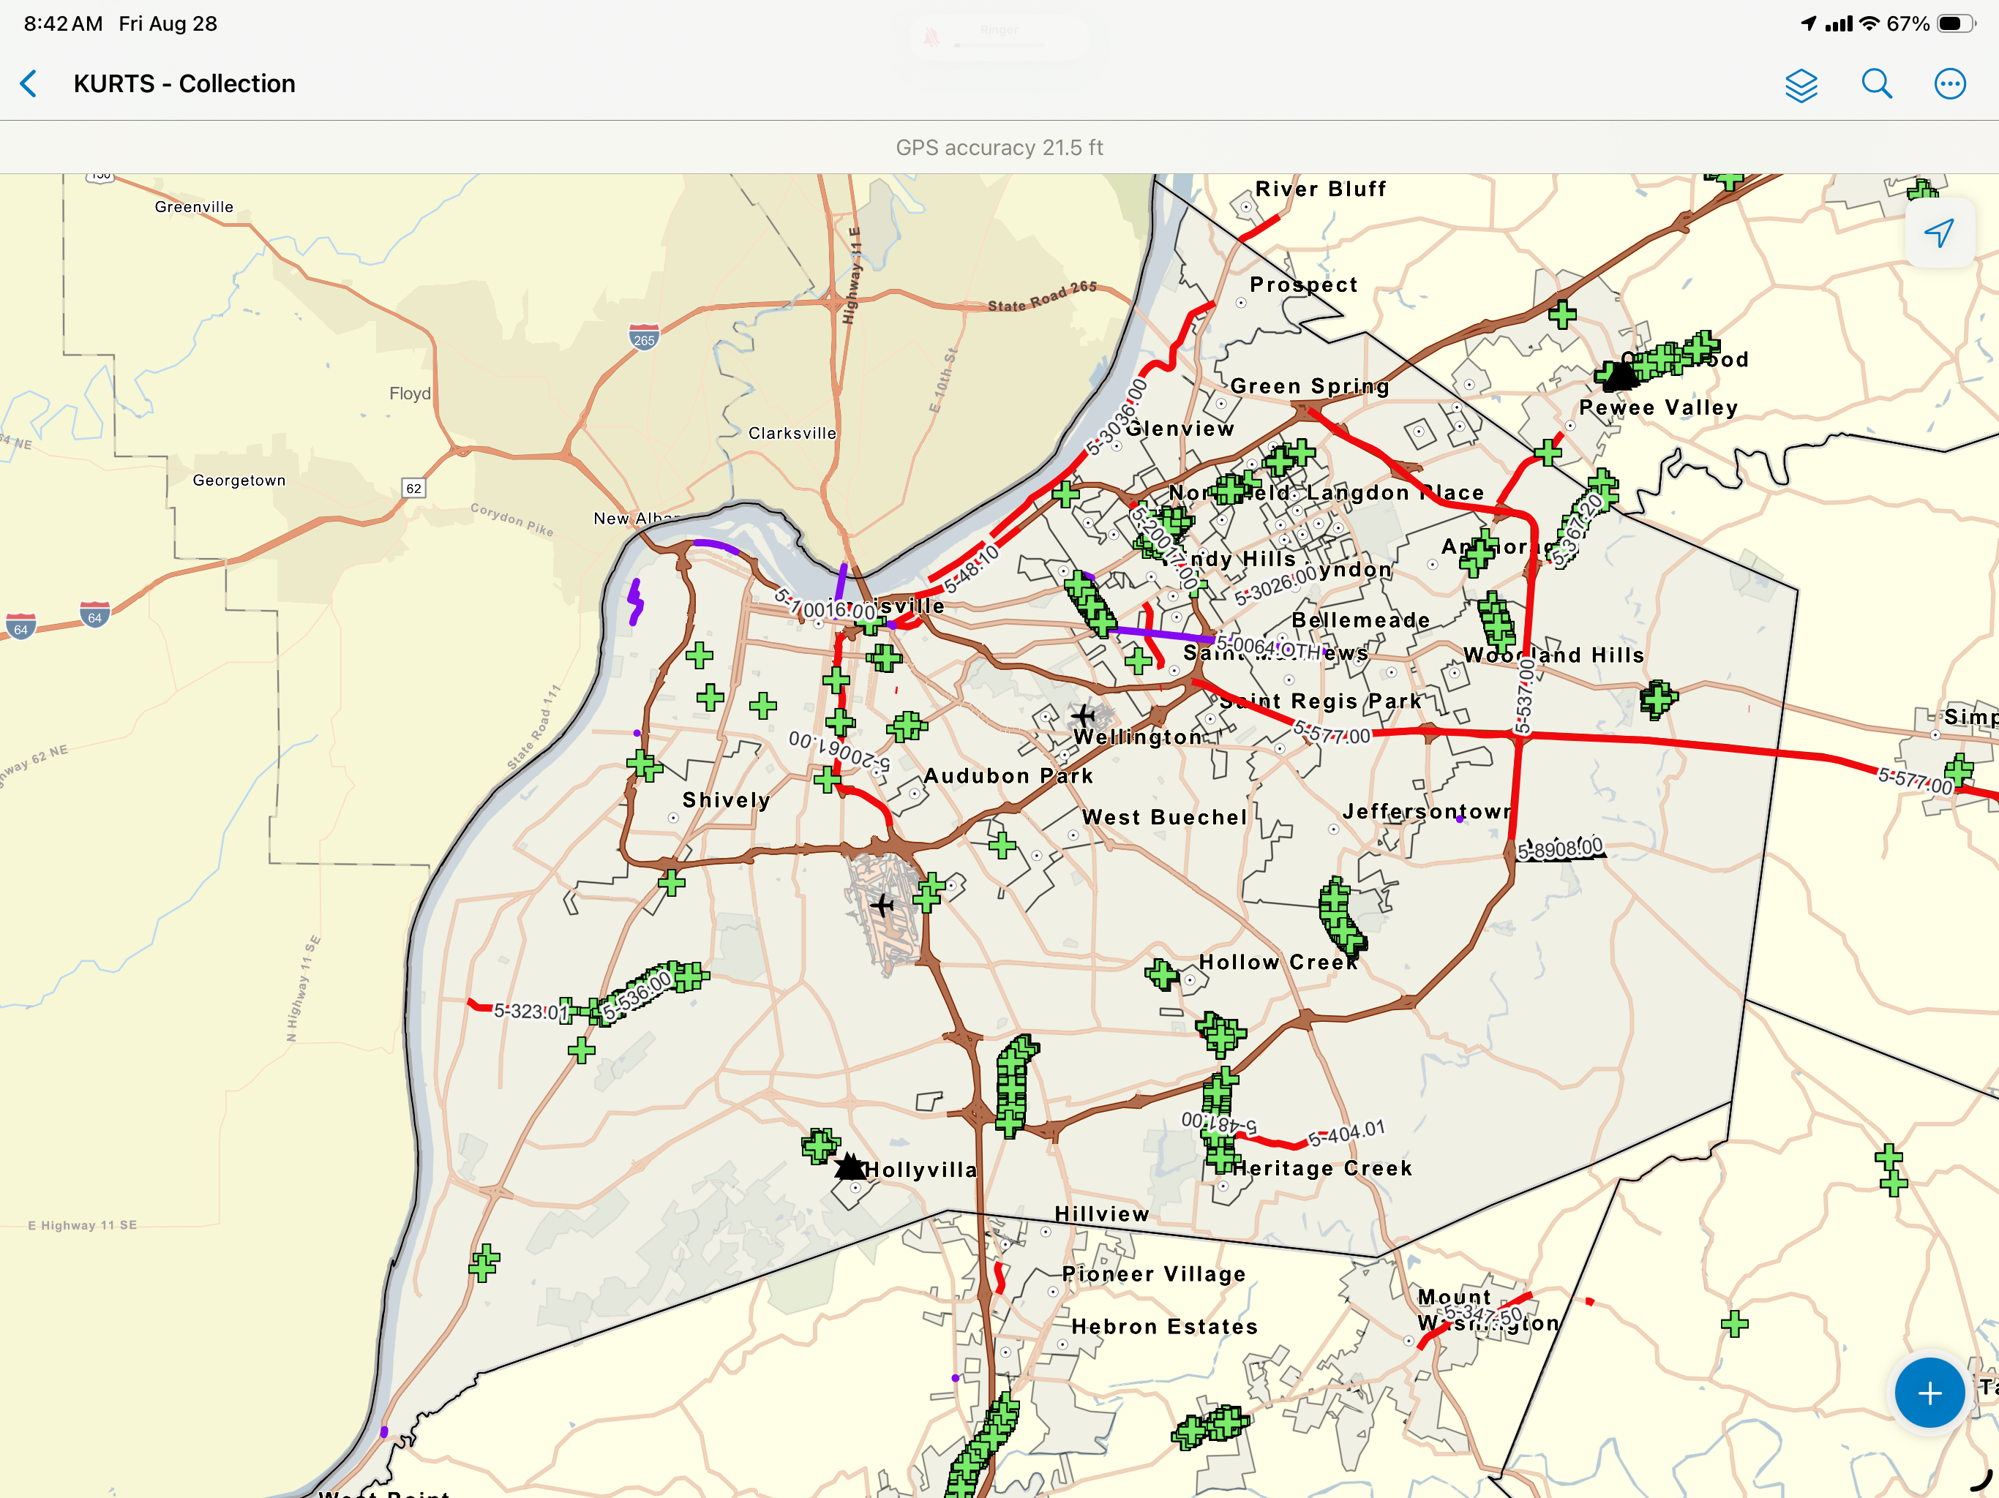
KURTS Mobile
Tap Here

Slide 18
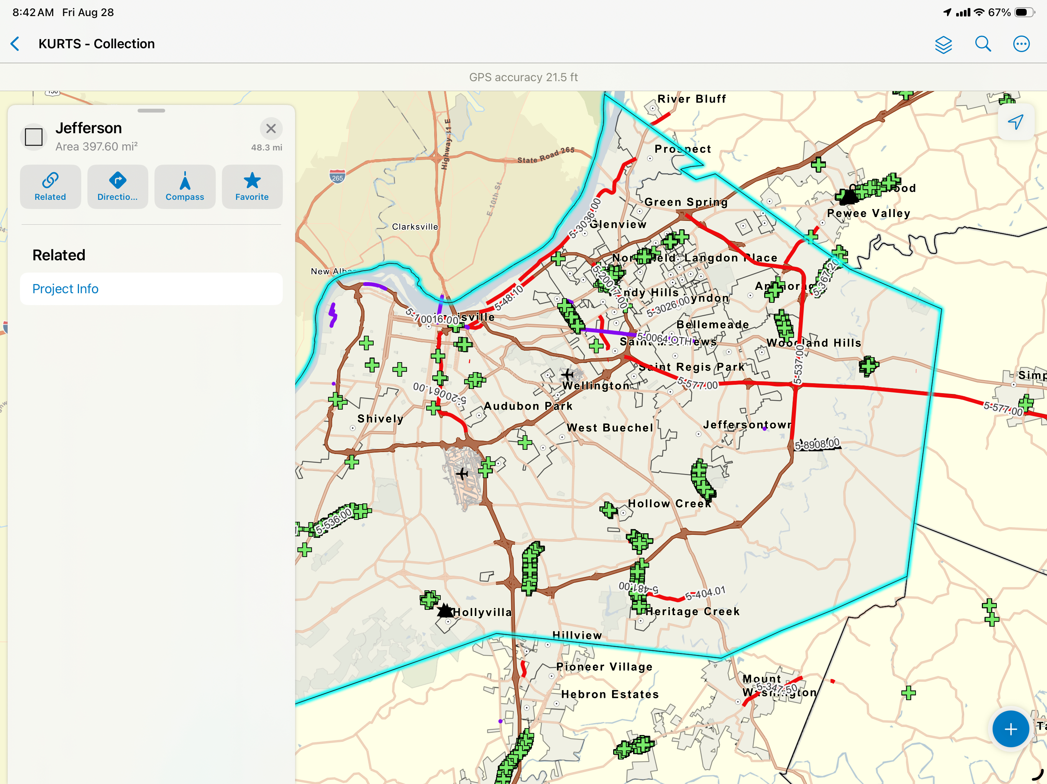
KURTS Mobile

Slide 19
KURTS Mobile

Slide 20
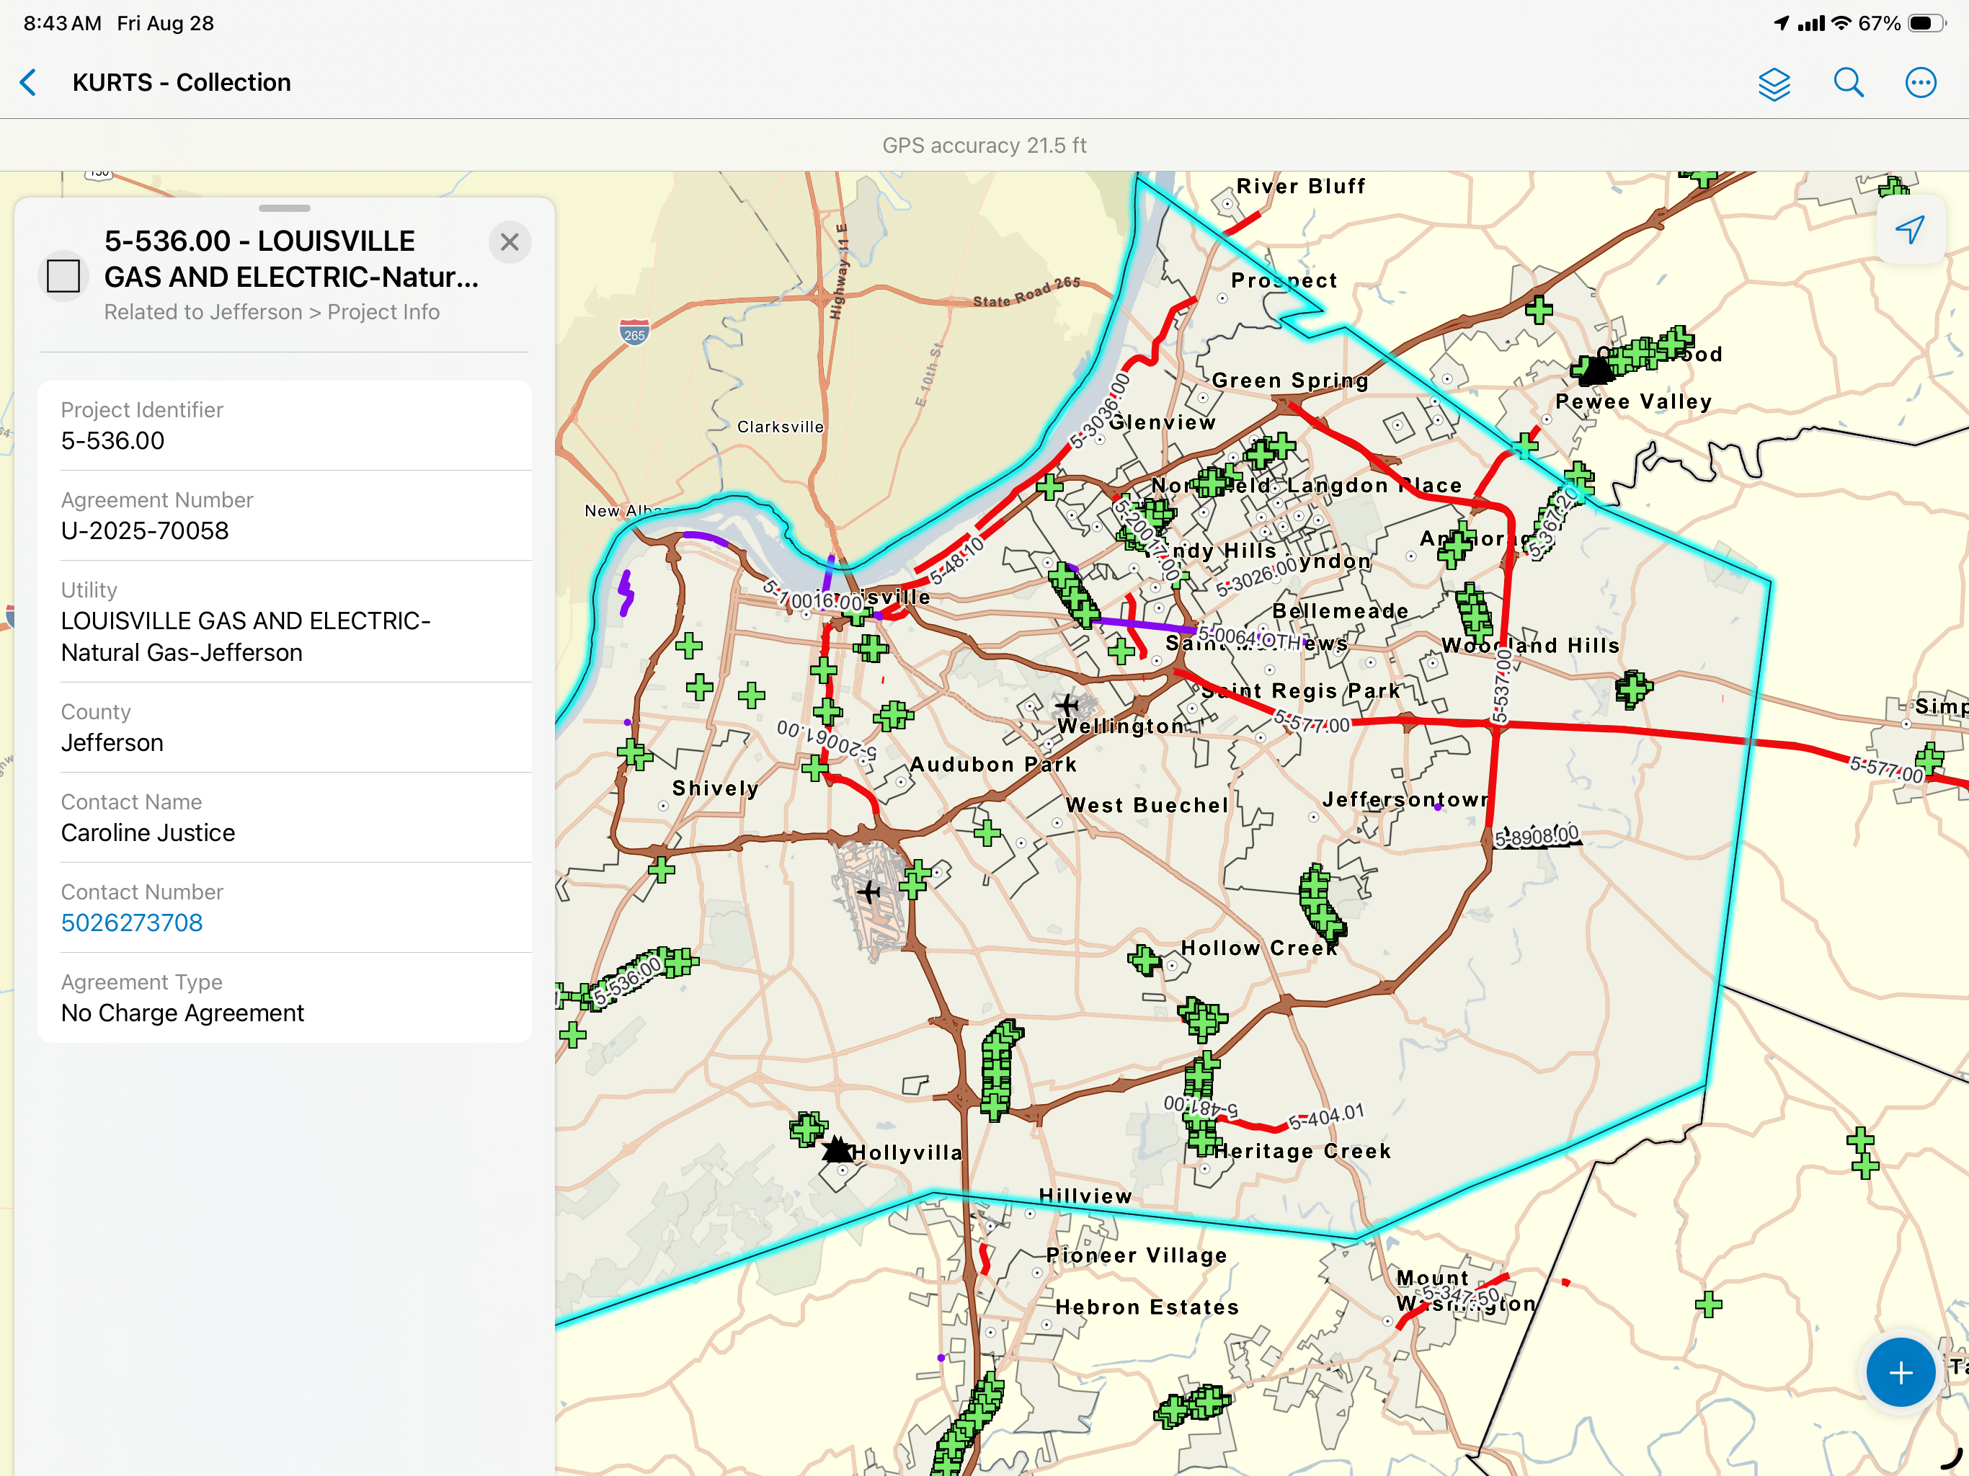
KURTS Mobile

Slide 21
KURTS Mobile

Slide 22
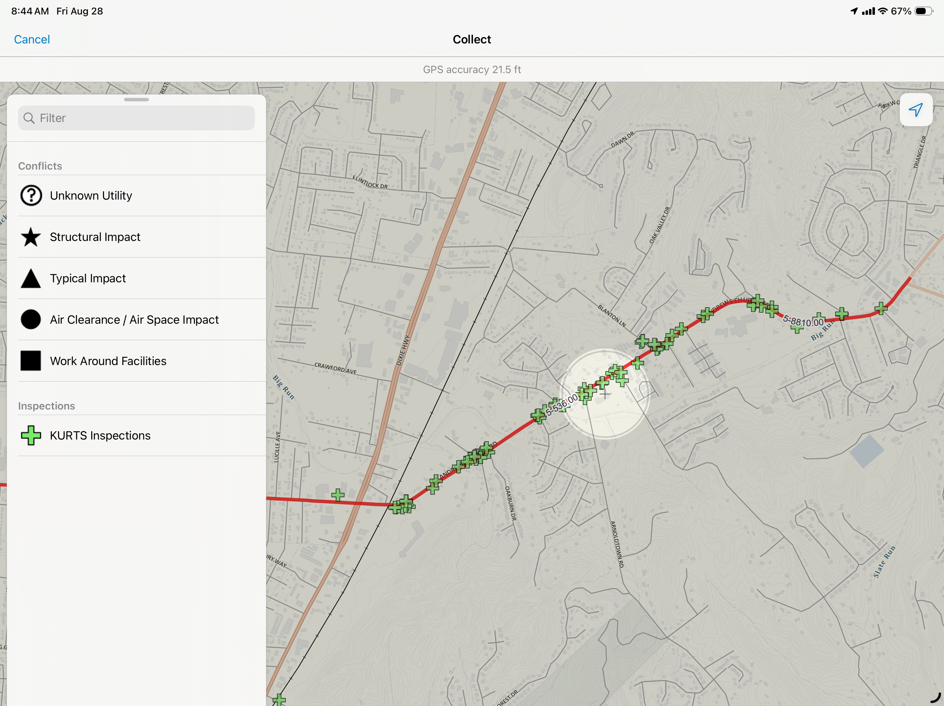
KURTS Mobile

Slide 23
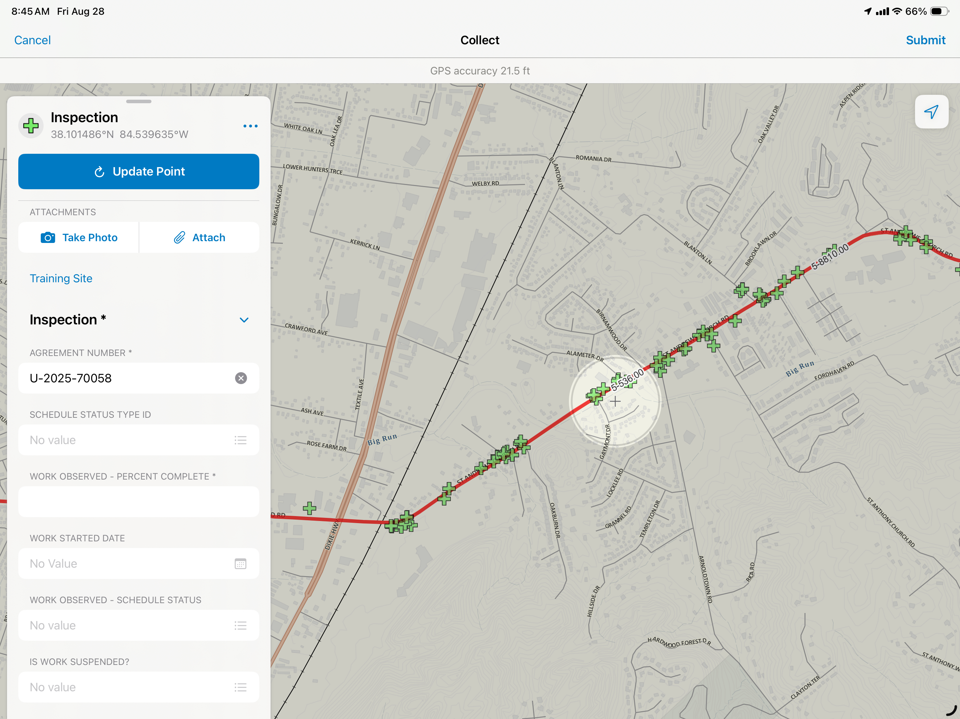
KURTS Mobile

Slide 24
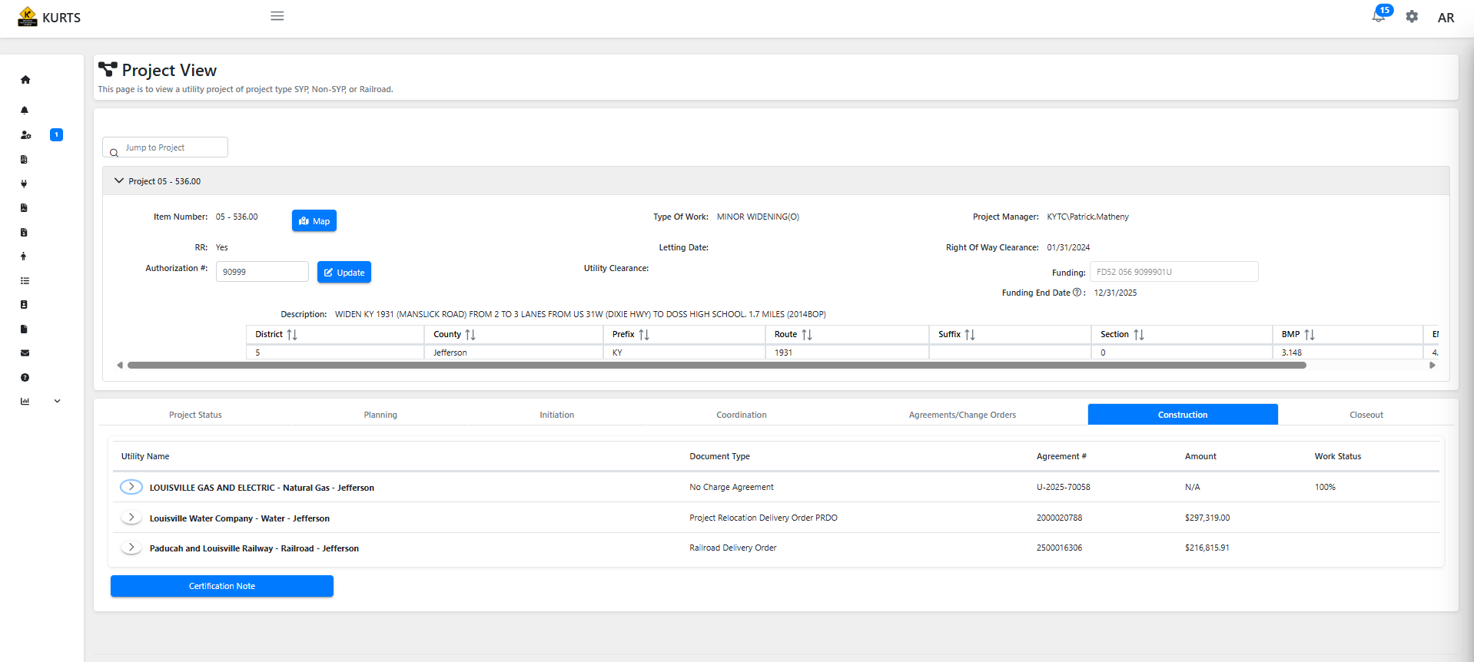
KURTS Web App

Slide 25
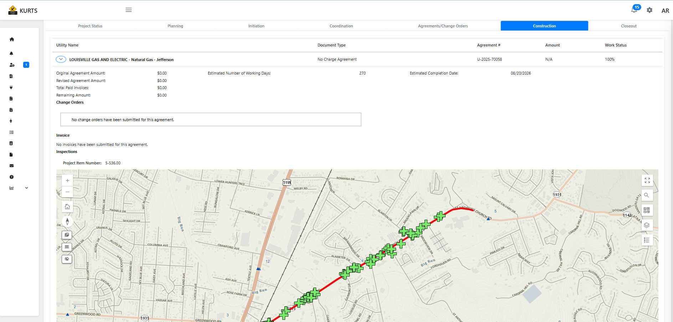
KURTS Web App

Slide 26
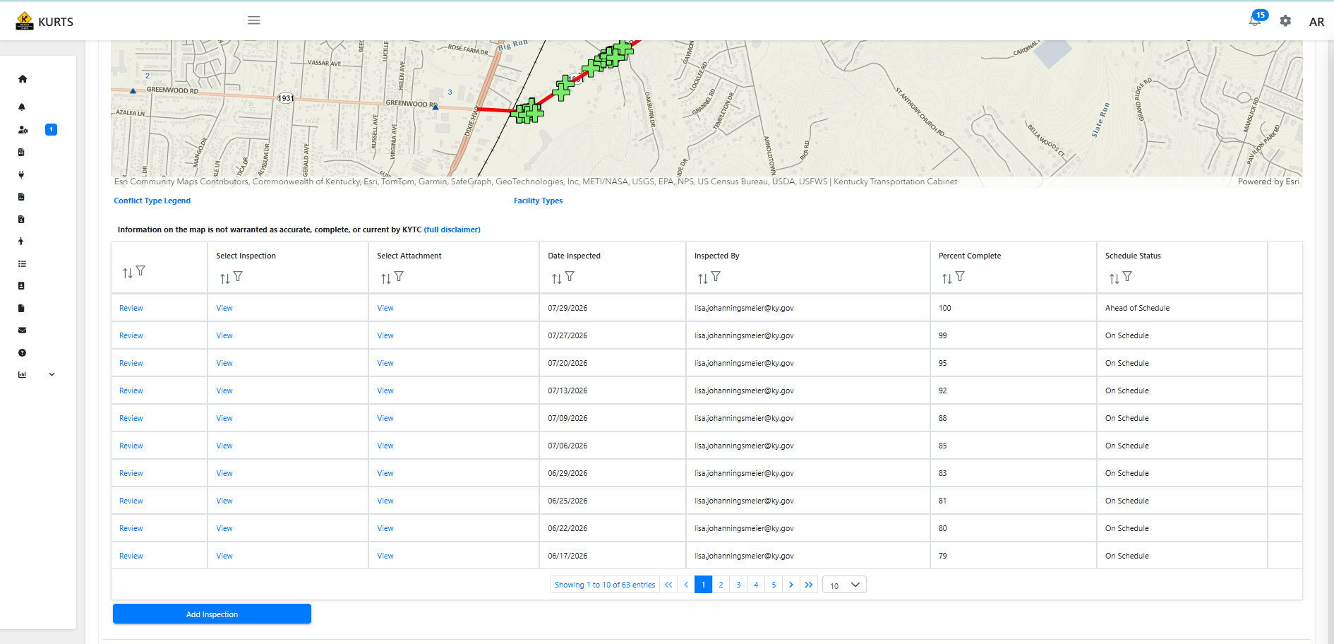
KURTS Web App

Slide 27
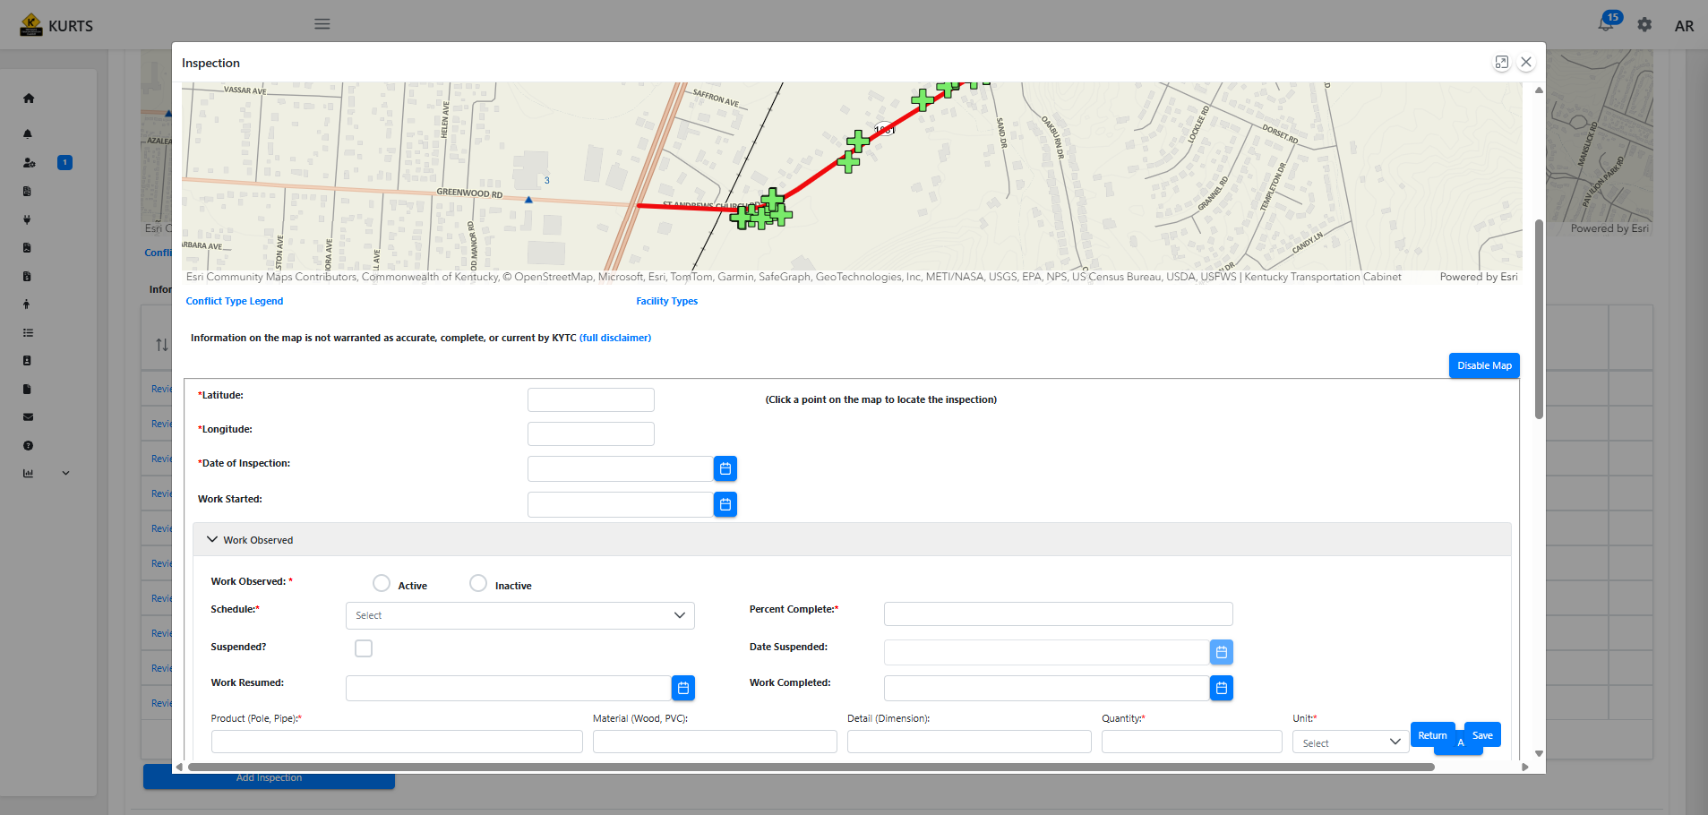
KURTS Web App

Slide 28
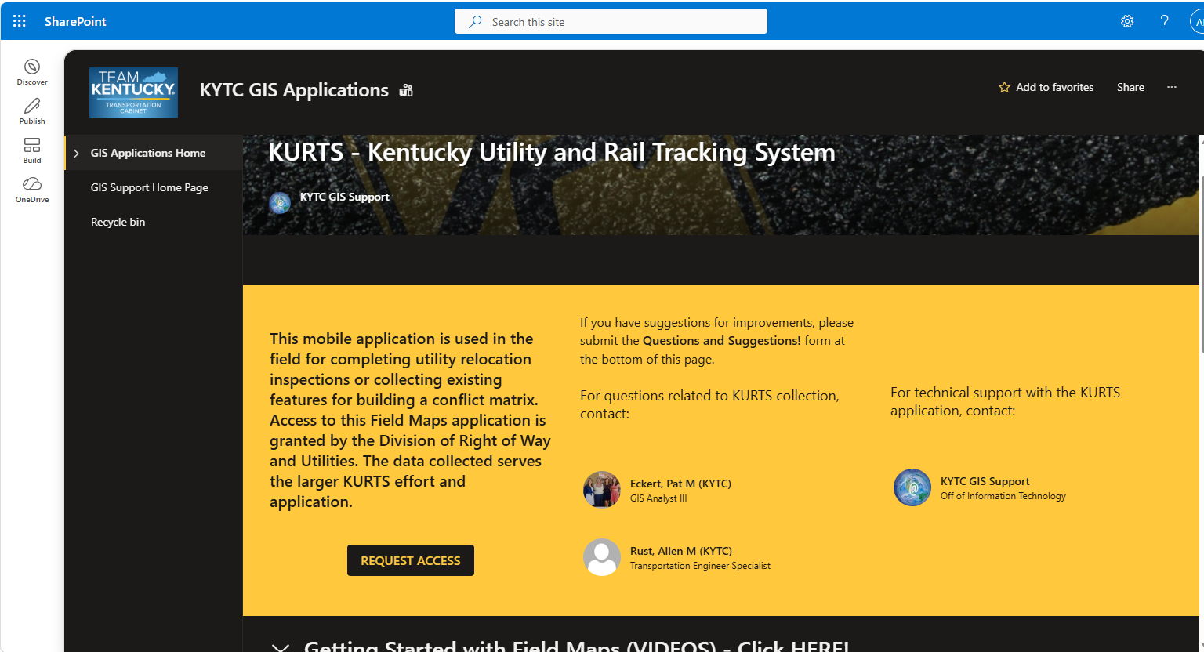
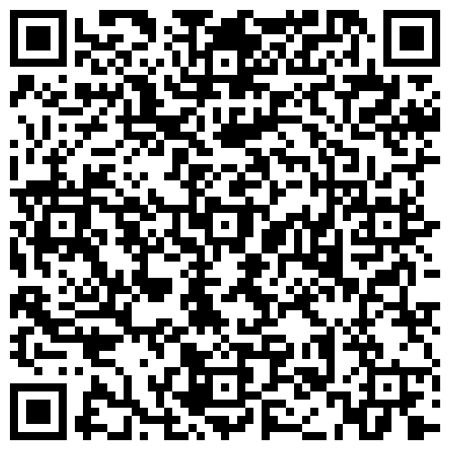
Request Access to KURTS Mobile
https://kymsoffice.sharepoint.com/sites/gisteam/KYTCGISSupport/KYTCGISApplications/SitePages/KURTS.aspx#about-kurts

Slide 29
Questions?
Lisa Johanningsmeier
Transportation Engineering Technologist III
District 5 Utilities Section
Lisa.Johanningsmeier@ky.gov
Allen Rust
Transportation Engineer Specialist
Central Office Rail Coordinator
Allen.Rust@KY.gov
Notes:
By going in the field, I’ve had the opportunity to build a relationship with those doing the actual work and the utility company inspectors. First time you see a crew, and they see KYTC on the vehicle, they think I’m there to tell them they are doing something wrong. Once they get to know me, they will reach out and let me know of changes, problems, or to ask questions.
Improve communications with the utilities.
We gain understanding of what it takes to move the utilities. I had construction experience when I started, but I didn’t know about utility construction other than 811 colors. 95% of the people in the field love the chance to teach someone what they are doing. I have learned a lot from them that I could have learned any other way.
I’m not stuck inside all day! But I do get to come in when the weather is bad.
And as I always tell the field crews before I leave, stay safe and have fun.

